Slide 1
GLTS 202
HAZARDS AND SAFETY IN THE LABORATORY
LECTURER: OPADELE A.E
ENEDAH,VALENTINE OKWUCHUKWU
COURSE: PHYSICS/ELECTRONICS
COURSE UNIT: 2 UNITS

Slide 2
PRESENTATION TOPIC: SCIENTIFIC LABORATORY HAZARDS
Laboratory Equipment Hazards:
Equipment related hazards; advantages and disadvantages.
Technological trends on scientific equipment.
Shock hazards for each equipment; advantages and disadvantages.

Slide 3
LABORATORY EQUIPMENT HAZARDS
In GLTS 201, We had a thorough review of the basis of laboratory hazards and its perspectives. But before we proceed to the most important part of this presentation, we have to still have a review about the fundamental explanation of what a laboratory and hazard is.

Slide 4
LABORATORY
Laboratory is a central or research hub where experimental procedures are carried out such as scientific, social, educational, religious with the intent to analyse and deduce acceptable results from those experiments.
HAZARD
A hazard is an agent which has the potential to cause harm to a vulnerable target. The terms "hazard" and "risk" are often used interchangeably. However, in terms of risk assessment, these are two very distinct terms.

Slide 5
HAZARDS IN THE LABORATORY
Hazards are divided into;
Chemical hazards e.g. corrosive, inflammable, toxic.
Electrical or mechanical hazards e.g. high voltage apparatus, machinery with moving parts.
Bio hazards e.g. pathogenic micro-organisms, biological tissues, animals, blood and other fluids(human and animal).
Radiological hazards e.g. manual handling of radioactive apparatus.
Physical hazards e.g. noise, radiation and manual handling.
Psychological hazards e.g. emotional stress, workplace bullying
Glassware Hazards

Slide 6
There are two major/important hazards which is the physical and chemical hazards.
According to OSHA(Occupational Safety and Health Administration), a chemical hazard is defined as a chemical which there is statistically significant evidence that accidents or chronic self effects may occur on exposed employees. E.g. of these chemicals covered by these definitions include; carcinogens and highly toxic agents.
OSHA also defined the physical hazardous chemically valid evidence that it is a combustible liquid, a compressed gas,explosive,flammable, an organic peroxide, an oxidizer, water reactive.
So therefore Laboratory equipment hazards can be seen as agents that can cause injuries or damage to the use of laboratory equipment by individuals.

Slide 7
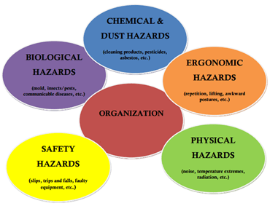
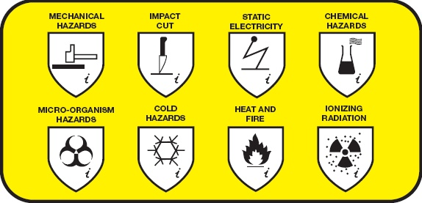
HAZARD CHARTS

Slide 8
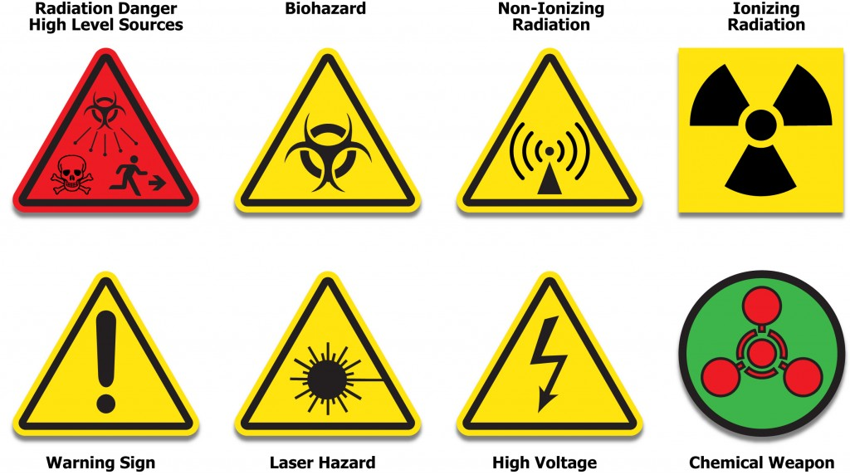

Slide 9
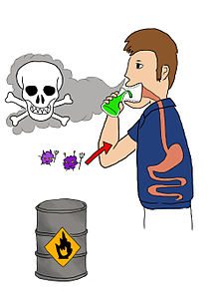

Slide 10

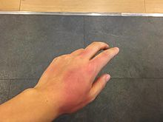
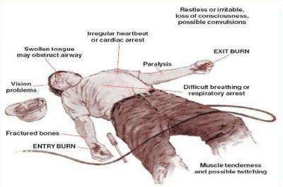

Slide 11
EQUIPMENT RELATED HAZARDS
Introduction
Numerous physical hazards may be present in the laboratory. While not as exotic as chemical and biological hazards, physical hazards are responsible for the majority of workplace injuries. It is important to be aware of these hazards, pre-plan, use personal protective equipment and follow basic safety rules in order to prevent accidents involving physical hazards.

Slide 12
Autoclaves
Autoclaves, hot-air ovens, incubators, and water-baths are devices for heating air or water. The heat is usually generated by an electrical module, but in some instruments heat is generated by fire, or there may be a heat-storage block, such as a separate water reservoir in solar systems or a metal block controlled by a thermostat.
Autoclaves present a number of physical hazards such as:
Heat, steam, and pressure.
Thermal burns from steam and hot liquids.
Cuts from broken or exploding glass.

Slide 13
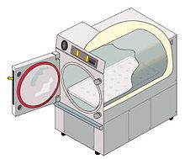
AN AUTOCLAVE

Slide 14
Batteries
Batteries are energy sources that generate electrical energy from stored chemical energy. The electrical current results from the oxidation and reduction processes of the metals that are used as electrode materials in the battery cell.
Batteries present a number of potential hazards. Charged batteries are “always on.” Care must be taken to ensure that electrodes of batteries in storage do not contact each other leading to fire. Lead acid batteries contain corrosive liquids and also generate hydrogen gas during charging which poses an explosion hazard. OSHA requires adequate ventilation to prevent hydrogen build up and an eyewash/safety shower in battery charging locations. Lithium batteries may burst into flames if overcharged, and nickel cadmium and lead acid types contain heavy metals. Almost all rechargeable batteries are capable of sufficient output current to start fires if short-circuited. Because of these sorts of hazards, and disposal considerations, a more detailed document has been developed.

Slide 15
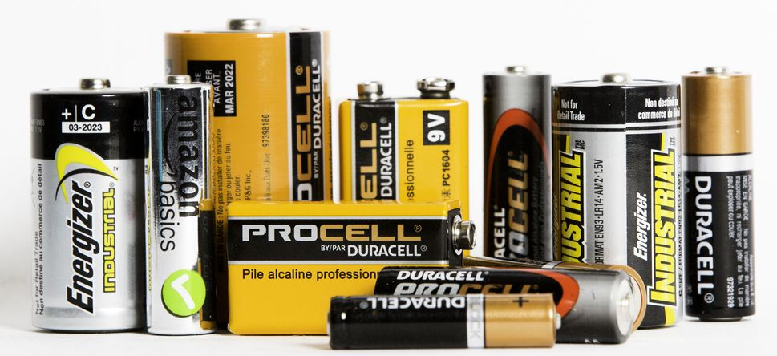
A BATTERY

Slide 16
I. Lead batteries
A lead battery is a liquid-system battery. The elements of a lead battery have narrow gratings filled with squamous lead (Pb) or squamous lead oxide (Pb02) as electrodes. These electrodes are kept apart by a porous separator membrane. The electrolyte is 20-30% sulphuric acid. The following chemical reactions provide energy during electrical discharge: Oxidation:
Pb + SO4 - ---> PbSO4 + 2e
Reduction: Pb02 + 4H+ + S04- + 2e------PbS04 + 2H20
These reactions go in the reverse direction when the battery is recharged.
Lead batteries are useful when a large capacity is required and a continuous supply of electricity is not reliably available. A 12 volt car battery or two 6 volt batteries can be used to supply any of the instruments in a hospital that run on 12 volts direct current. Many instruments can run on lead batteries, for example room illumination, water pumps, refrigerators, and mechanical tools. Lead batteries can be recharged from the mains supply, or by a photovoltaic solar-powered system independently of the mains.
Use of lead batteries
A lead battery must be protected from overcharge, because of water loss from the cells. It must also be protected from too heavy a discharge since this will drastically shorten the life of the battery.

Slide 17
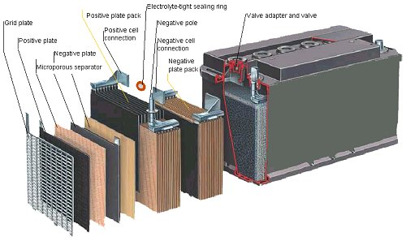

Slide 18
Use of lead batteries
A lead battery must be protected from overcharge, because of water loss from the cells. It must also be protected from too heavy a discharge since this will drastically shorten the life of the battery. The battery can be checked by measuring the laboratory equipment voltage with a multimeter. This check also gives information about the actual capacity of the battery.
For a 12 volt lead battery to be recharged at an ambient temperature of 30 °C the limit values are:
maximum voltage for recharge: 13.9 volt (additional charging will cause high losses of water)
minimum voltage for recharge: 11.2 volt.
The battery should be recharged when it has a residual capacity of about 30%. Additional discharge shortens the life of the battery considerably.

Slide 19
C. Centrifuge
A centrifuge is a machine that applies a sustained centrifugal force (i.e., a force due to rotation) to impel matter outwards from the centre of rotation. This principle is used to separate out particles in a liquid medium by sedimentation. The physical basis of the separation is the action of a centrifugal force on the rotating particles, which increases with the radius of the rotational field and the velocity of the rotation. The rate of sedimentation is determined by the density of the particles. Dense particles sediment first, followed by lighter particles. Depending on the conditions, very light particles may even remain in suspension.

Slide 20
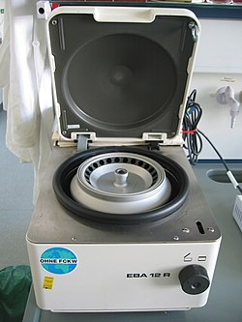
A CENTRIFUGE

Slide 21
There are two main types of centrifuge: preparative and analytical.
Preparative centrifuges are used to separate the solids suspended in biological samples from the supporting fluid. This is the most common type of centrifuge, and they are fitted with swing-out, or fixed-angle, heads.
Preparative centrifuges vary in their sample capacity and size, from floor-standing to small capacity centrifuges that can be sited on a bench.
Some are fitted with internal wind shields to protect the operator from contamination by any aerosols that may be formed. This is now a mandatory safety requirement in many countries.
Two types of preparative centrifuge are currently used-mechanical and electrical -although the majority are electrical centrifuges.
Analytical centrifuges may be used to quantify one or more solid components in a mixed suspension. The only centrifuge of this type used in medical laboratories is the micro haematocrit centrifuge.

Slide 22
1. Some general safety guidelines to follow when using centrifuges:
• Be familiar with the operating procedures written by the manufacturer. Keep the operating manual near the unit for easy reference. If necessary contact the manufacturer to replace lost manuals.
• Handle, load, clean, and inspect rotors as recommended by the manufacturer.
• Pay careful attention to instructions on balancing samples -- tolerances for balancing are often very restricted. Check the condition of tubes and bottles. Make sure you have secured the lid to the rotor and the rotor to the centrifuge.
• For ultracentrifuges, maintain a logbook of rotor use for each rotor, recording the speed and length of time for each use.

Slide 23
• To avoid catastrophic rotor failure, some types of rotors must be "de-rated" (limited to a maximum rotation speed that is less than the maximum rotation speed specified for the rotor when it is new) after a specified amount of use, and eventually taken out of service and discarded.
• Use only the types of rotors that are specifically approved for use in a given centrifuge unit.
• Maintain the centrifuge in good condition. Broken door latches and other problems should be repaired before using the centrifuge.
• Whenever centrifuging biohazardous material, always load and unload the centrifuge rotor in a biological safety cabinet. Avoid pop-top tubes which can create aerosols upon opening. Use screw capped tubes instead

Slide 24
Centrifuge Rotor Care
Basic centrifuge rotor care includes:
• Keep the rotor clean and dry, to prevent corrosion.
• Remove adapters after use and inspect for corrosion.
• Store the rotor upside down, in a warm, dry place to prevent condensation in the tubes.
• Read and follow the recommendations in the manual regarding:
Regular cleaning
Routine inspections
Regular polishing
Lubricating O-rings
Decontaminating the rotor after use with radioactive or biological materials
• Remove any rotor from use that has been dropped or shows any sign of defect, and return it to a manufacturer’s representative for inspection.

Slide 25
Good working practices
Preparative centrifuges
• The centrifuge must be positioned exactly horizontally to avoid movement if the instrument is out of balance during operation.
• It is critically important that the centrifuge load is balanced at all times. Therefore, tubes should be loaded in matched buckets fitted with rubber cushions, and should be arranged so that like loads are opposite. A "dummy", i.e., a tube containing the appropriate volume of water, must be included when an odd number of specimens are to be centrifuged. Final balancing should be carried out by placing paired loads on the two pans of a reasonably sensitive balance, and balancing by adding water from a bottle or Pasteur pipette; if possible, add water to the lighter of the two samples, so that it balances the heavier load. Biological samples should be capped during centrifugation.

Slide 26
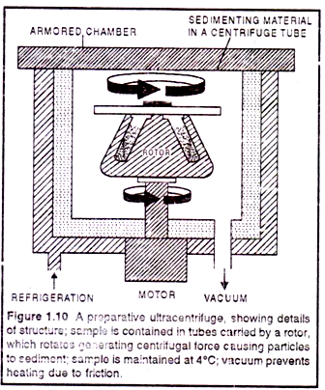
A PREPARATIVE CENTRIFUGE

Slide 27
The centrifuge should be stopped immediately if it develops an abnormal noise, indicating that it is not properly balanced.
• After use the buckets should be inverted to drain dry.
• After any sample spillage, always clean up the buckets and the centrifuge and disinfect with 70% (700 ml/I) alcohol immediately.
• Clean and disinfect the centrifuge often, because it is one of the most frequently used instruments.
• Check mountings and replace if necessary.
• Check motor brushes and replace if necessary.
• Check for corrosion and clean if necessary.
• Never operate a centrifuge with the lid open.
• Do not use the centrifuge at higher speeds than necessary

Slide 28
Haematocrit centrifuges
Haematocrit centrifuges need not be balanced before use. As the samples are small capillary tubes, and the forces relatively low, it is only necessary to load the samples symmetrically. Never run the centrifuge with the lid open. Capillaries should be plugged at one end with the recommended sealing compound. The plugged end should always be placed against the sealing gasket. Even with the above precautions, it is. possible that blood may leak from the bottom of the capillary. After any spillage, the centrifuge chamber must be disinfected and cleaned immediately with soap solution, and then with 70% (700 ml/I) alcohol.
Hazards/safety:
Because centrifuges are regularly used to prepare blood and urine samples, it is recommended that the rotor bowl, centrifuge head, buckets and trunnion rings be disinfected before any servicing is carried out.

Slide 29
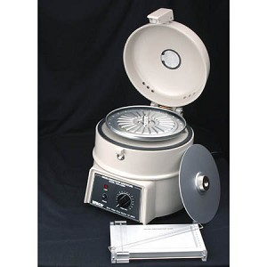
HAEMOCRIT CENTRIFUGE

Slide 30
D. Glassware hazards
Basically, Glassware hazards are hazards gotten from the use of glass equipment.
The following are hazards related to glassware:
Cuts from damaged or broken glass.
Cuts from flying glass due to implosion following evacuation or mechanical shock or stress.
Cuts from forcing plastic tubing, teats or rubber bungs onto glass tubing, pipettes or condensers that break.
Cuts from broken glass and sharp items e.g. Pasteur pipettes disposed in ordinary waste bins.
Burns from heated glass.
Poisoning following cuts by contaminated glassware.

Slide 31

GLASS TUBES

Slide 32
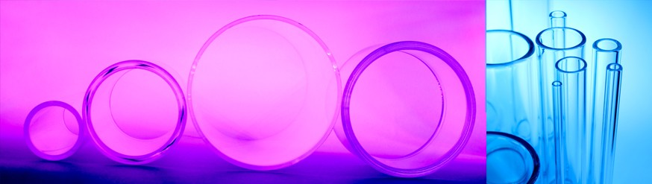
GLASS TUBES

Slide 33
1. General Information about Glass and Plastic Ware
• Borosilicate glassware (i.e. Pyrex, Kimax) is recommended for all lab glassware, except for special experiments using UV or other light sources. Soft glass should only be used for un-heated things such as reagent bottles, measuring equipment, stirring rods and tubing.
• Glass containers of hazardous chemicals should be transported in rubber bottle carriers or buckets to protect them from breakage and contain any spills or leaks. It is recommended to transport plastic containers this way as well since they also can break or leak.
• Plastic containers can deteriorate with time, typically becoming yellow and brittle. The process is accelerated by exposure to solvents, sunlight, and heat. Be particularly aware of hazardous chemicals stored for a long time in plastic bottles. Also, exercise caution with older plastic pails in which handles may break off, or bottoms crack.
• Some plastic containers generate static that can ignite flammable vapours.
Avoid storing flammables in unapproved plastic containers.

Slide 34
2. Handling
• When handling glassware, check for cracks and chips before using it. Damaged glassware must be repaired (if an option) before use or disposed.
• Handle glassware with care – avoid impacts, scratches, and intense heating of glassware.
• Use care when inserting glass tubing into stoppers: use glass tubing that has been fire-polished, lubricate the glass, and protect your hands with heavy gloves.

Slide 35
3. Preparation of Glass Tubing and Stoppers
• To cut glass tubing:
Hold the tube against a firm support and make one firm quick stroke with a sharp triangular file or glass cutter to score the glass long enough to extend approximately one third around the circumference.
Cover the tubing with cloth and hold the tubing in both hands away from the body. Place thumbs on the tubing opposite the nick 2 to 3 cm apart and extended toward each other.
Push out on the tubing with the thumbs as you pull the sections apart, but do not deliberately bend the glass with the hands. If the tubing does not break, re-score the tube in the same place and try again. Be careful to not contact anyone nearby with your motion or with long pieces of tubing.
All cut lab glass, including stir rods, should be fire polished before use. Unpolished tubing can cut skin, and inhibit insertion into stoppers by tearing the rubber. After polishing or bending glass, give ample time for it to cool before grasping it. Hot glass looks just like cold glass!

Slide 36
• When drilling a stopper:
Use only a sharp borer one size smaller than that which will just slip over the tube to be inserted. For rubber stoppers, lubricate with water or glycerol. Holes should be bored by slicing through the stopper, twisting with moderate forward pressure, grasping the stopper only with the fingers, and keeping the hand away from the back of the stopper.
Keep the index finger of the drilling hand against the barrel of the borer and close to the stopper to stop the borer when it breaks through. Preferably, drill only part way through and then finish by drilling from the opposite side.
Discard a stopper if a hole is irregular or does not fit the inserted tube snugly, if it is cracked, or if it leaks.
Corks should have been previously softened by rolling and kneading. Rubber or cork stoppers should fit into a joint so that one-third to one–half of the stopper is inserted.
When available, glassware with ground joints is preferable. Glass stoppers and joints should be clean, dry and lightly lubricated.

Slide 37
• Insertion of Glass Tubes or Rods into Stoppers:
Make sure the diameter of the tube or rod is compatible with the diameter of the hose or stopper.
If not already fire polished, fire polish the end of the glass to be inserted; let it cool
Lubricate the glass. Water may be sufficient, but glycerol is a better lubricant.
Wear heavy gloves or wrap layers of cloth around the glass and protect the other hand by holding the hose or stopper with a layered cloth pad.
Hold the glass not more than 5 cm from the end to be inserted. o Insert the glass with a slight twisting motion, avoiding too much pressure.
When helpful, use a cork borer as a sleeve for insertion of glass tubes.
If appropriate, substitute a piece of metal tubing for glass tubing.
Remove stuck tubes by slitting the hose or stopper with a sharp.

Slide 38
4. Cleaning
In most cases laboratory glassware can be cleaned effectively by using detergents and water. In some cases it may be necessary to use strong chemicals for cleaning glassware. Strong acids should not be used unless necessary. In particular, chromic acid should not be used due to its toxicity, carcinogenicity, and disposal concerns. One product that may be substituted for chromic acid is “Nochromix Reagent”. Generally, it is cheaper to dispose of grossly contaminated glassware as non-RCRA lab trash than to generate hazardous waste rinsate trying to decontaminate the glassware for disposal as regular trash.

Slide 39
5. Disposal
Broken glassware must be managed to prevent injury. See Section 5.6 of the DRI Hazardous Waste Generation Satellite Accumulation SOP for disposal information. Put other sharps such as pipette tips and razor blades into puncture resistant containers before disposal. Normal sharps can then be placed in the regular trash. If you are generating hypodermic needles, contact EH&S for disposal information specific to your work location. Glassware and sharps that are grossly contaminated with hazardous materials will be shipped with similarly contaminated lab trash. If glassware/sharps are contaminated with human blood/body fluids or radioactive materials.

Slide 40
Mechanical Hazards
Mechanical hazard are created as a result of either powered or manual(human) use of tools, equipment or machinery and plant. An example of mechanical hazard is; contact and/or entanglement with unguarded moving parts on a machine.
Where do mechanical hazards occur
Dangerous moving parts in three basic areas require safeguarding
The point of operation: that point where work is performed on the material, such as cutting, shaping, boring, or forming of stock.
Power transmission apparatus: all components of the mechanical system that transmit energy to the part of the machine performing the work. These components include flywheels, pulleys, belts, connecting rods, couplings, cams, spindles, chains, cranks, and gears.
Other moving parts: all parts of the machine that move while the machine is working. These may include reciprocating, rotating and transverse moving parts, as well as feed mechanisms and auxiliary parts of the machine.

Slide 41
Some of the injuries that can occur as a result of mechanical hazards are as follows:
impact-being hit by ejected parts of the machinery or equipment
Friction and abrasion- e.g. use of sander
Entrapment-being caught in a moving part of a machine or equipment or plant
Stabbing and puncture- e.g. nail gun use
High pressure fluid injection-a pinhole leak in a hydraulic hose can burst and inject hydraulic oil into a person’s hand for example
Shearing- can be two moving parts(sharp or otherwise) moving across one another.
Cutting- severing of a human body part by a cutting motion e.g. amputation of finger on a cutting machine.
Entanglement- for example a loose sleeve getting caught in a moving part and drawing the person into the machine.

Slide 42
If working with these mechanical equipment, follow these safety guidelines:
• Avoid wearing loose fitting clothing or necklaces that could be drawn into a rotating assembly.
• Do not defeat interlocks on doors, access panels, etc.
• Do not brake moving parts by hand; wait for motion to stop on its own.
• Be aware of assemblies that vibrate and could “walk” into other objects or fall off a counter.
• Safety glasses must always be worn around any power tool operation.
• Use caution with automatic or computer-controlled machines that could start unexpectedly. This is covered in greater detail in Section D, Electrical Safety in this document and under the DRI Energy Control (lock-out/tagout)Program.

Slide 43
Vacuum Hazards
Many laboratories employ vacuum apparatus for analytical equipment like mass spectrometers, reactive chemical handling and transfer in Schlenk lines, filtration, and desiccation.
1. Some general guidelines for glass apparatus under vacuum include:
• Inspect glassware that will be used for reduced pressure to make sure there are no defects such as chips or cracks that may compromise its integrity.
• Use only approved glassware for low pressure work. Never use a flat bottom flask (unless it is a heavy-walled filter flask) or other thin-walled flask that is not appropriate to handle atmospheric pressure.
• Use a shield between the user and any glass under vacuum or wrap the glass with tape to contain any glass in the event of an implosion.
• Glass Dewar flasks, some distillation columns, CRTs, and other apparatus are permanently under vacuum. The same precautions apply to these items.
Note that “Thermos” flasks are especially thin and prone to breakage. Wrap them with tape to contain glass shards in the event of an implosion.

Slide 44
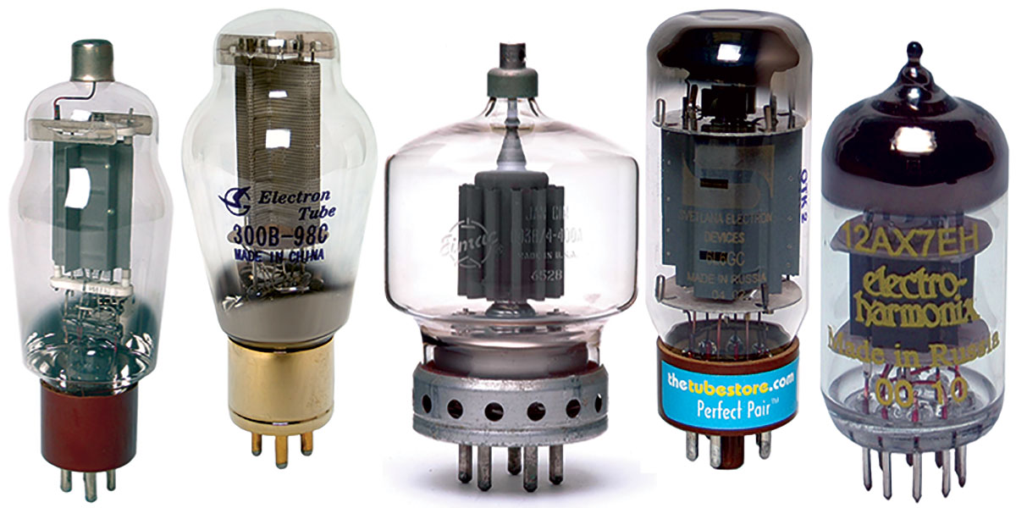
VACUUM TUBES

Slide 45


Slide 46
Vacuum system
• Cold traps should be used to prevent pump oil from being contaminated which can create a hazardous waste or contaminate the pump.
• Pump exhaust should be vented into a hood when possible.
• Belts, pulleys, and other moving parts must be properly guarded.
• Follow appropriate lock-out procedures if you cannot directly unplug the device for maintenance. Pumps may start automatically.
• Connect pump inlet and outlet properly. Pump connections can look the same. Reversing the flow direction can pressurize your apparatus leading to an explosion. At minimum you will contaminate it with oil.

Slide 47
• Allow diffusion pumps to cool completely before venting or servicing. These pumps contain oil at very high temperature. Keep combustibles away.
• Do not cryopump reactive materials. Condensing or adsorbing oxygen, ozone, and flammable and/or reactive gases is dangerous. Upon warming, in the case of pump regeneration or power outage, those adsorbed gases may react violently causing an explosion.
• Used pump fluids must be managed. Oil removed from vacuum pumps for disposal should be labelled “used oil” unless a known contaminant is present.

Slide 48
• Use extra caution with vacuum evaporator applications. Some evaporated films are air reactive, and others may generate particles that can be inhaled. Determine any possible health hazards with process products and protect yourself accordingly. It’s a wise practice to minimize exposure to all respirable nanomaterials as risks are yet unknown.
• Many vacuum gauges are also ignition sources. Hot filaments in BA type ionization gauges and thermocouple gauges and high voltage in cold cathode gauges may all ignite organic vapours of flammable gases.

Slide 49
Radiological Hazards
These are hazards related to the use of radioactive substances and equipment.
Some examples of radiation use at DRI include:
1. Ionizing radiation sources:
• Radioactive Materials
Sealed sources generating alpha, beta, or gamma radiation, primarily for calibration or completely contained in instruments (like soil moisture meters).
Radioactive solids, liquids, and gases used as tracers, markers, and electron microscopy stains.
• Radiation Generating Equipment
X-ray diffraction apparatus
X-ray generators for other analytical devices
Electron microscopes

Slide 50
2. Non-Ionizing radiation sources:
• Radio Frequency Devices
Microwave generators
Radio frequency generators
Lasers
Visible
Invisible (Infrared or UV)
Pulsed or Continuous.
Ultraviolet Light Sources (considered non-ionizing for our purposes)
Plasma flames in spectrometers
Germicidal lamps in biosafety cabinets
Trans illuminating lamps

Slide 51
The use of radioactive materials or radiation producing equipment is managed by the UNR Radiation Safety Officer under the University of Nevada, Reno’s Nevada State radiation license. Larger lasers (class IIIb and above) and open use of significant power microwaves or RF will also require pre-approval by the UNR RSO. For further information contact DRI EH&S or the UNR RSO at 775-784-4540.
2014.

Slide 52
TECHNOLOGICAL TRENDS ON SCIENTIFIC EQUIPMENT

Slide 53
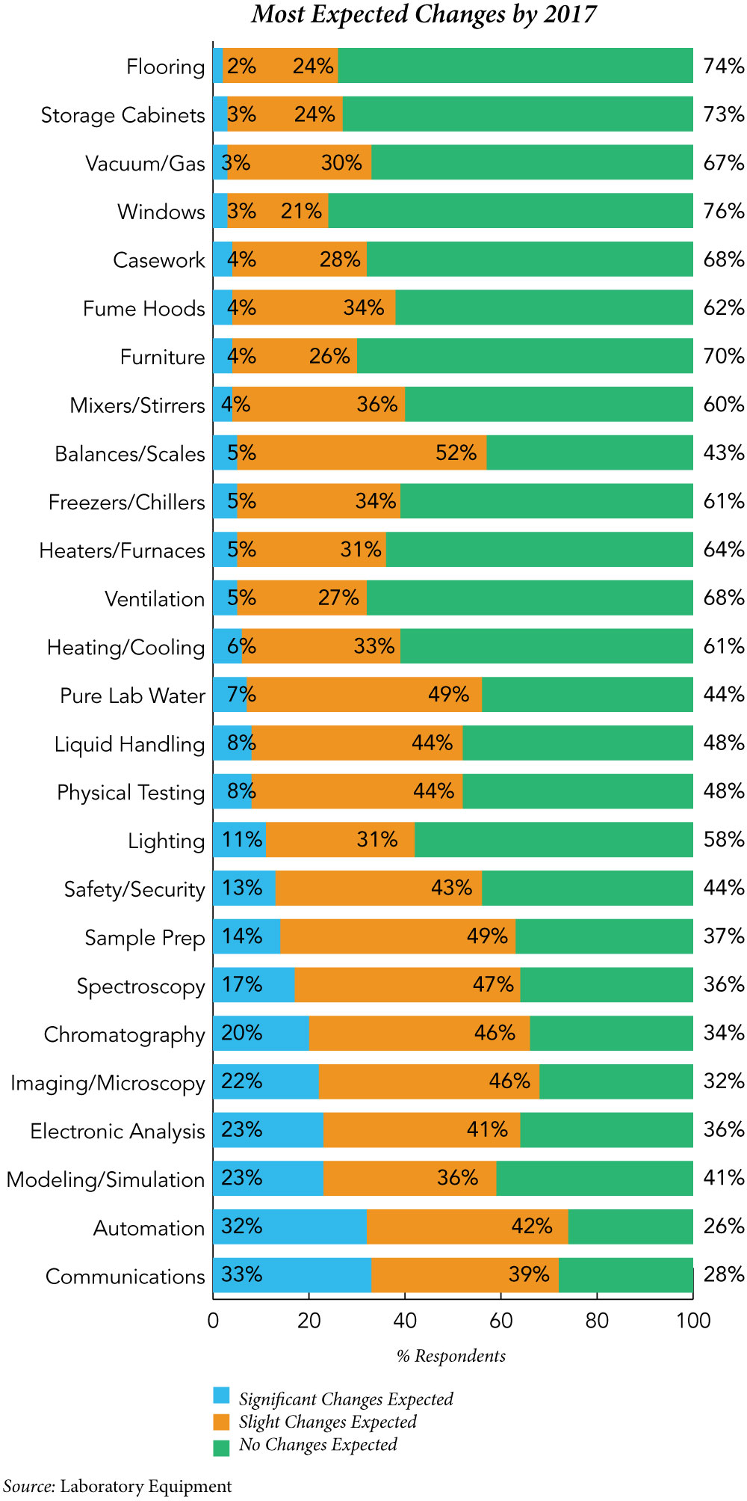

Slide 54
Researchers rely on analytical instruments and basic lab equipment on a daily basis. Advanced technologies are continually employed in the lab to solve problems, improve existing solutions and help achieve the goals set by and for researchers. While there are numerous motivators for designing more advanced instrumentation, improved strategies for sustainability goals in the lab are putting more emphasis on lab design and furnishings than was the trend in previous years. Energy efficiency, operating costs, researcher productivity and the minimization of waste products and construction materials are some of the essential sustainability components in the operation of the modern research lab.

Slide 55
Technological change in the lab, though, has a more topical basis in the evolutionary implementation of rapid changes in electronics, software, system integration, nanotechnologies, micro processing and microfabrication. Of course, researchers still keep sustainability firmly in their sights when choosing new advanced instruments and equipment.
For this year’s Lab Trends Report, the editors of Laboratory Equipment surveyed readers on the trends they see now and expect to see in the future concerning new technologies, operational trends, purchasing plans and globalization effects and trends. Those results are the partial basis for this report. Also included in this year’s report are personal interviews with researchers from government, academic and industry labs on similar topics.

Slide 56
Future changes
When asked about the level of technology changes researchers expect to see over the next three years, the majority of responders stated that sophisticated analytical instruments would see the most significant changes (and fewest “no change” responses), while basic lab equipment would see slightly fewer significant changes. Specific survey responses are shown on the chart to the right.
Communications and networking systems in the research laboratory are expected to see the most significant changes over the next three years—only 25% of the survey respondents expect to see no change in their systems by 2017. This was not unexpected as this area is seeing the most dramatic changes in hardware and software technologies and regulatory areas as more analytical systems and even equipment go wireless, and wireless itself increases in bandwidth and mobile applications. Technology influencers in this area originate in real-world applications and social trends.

Slide 57
Many of the changes being seen in communication and networking systems are literally “game changers.” Organizations, for example, are starting to develop the required infrastructures for BYOD (bring your own device) systems that include storage, analytics and processing systems. At this point, BYOD refers only to computational capabilities, not analytical instrumentation, although those capabilities may also evolve over the next 10 years. But even the computational-only initiatives can dramatically increase the productivity of researchers while giving them more in-depth control over their projects. However, they also create significant issues concerning security and control of the organization’s IP (intellectual property) by allowing that information to reside outside the walls of the organization. This effect will likely require organizations to refine their information access protocols and establish new procedures for enforcement.

Slide 58
Mobile devices, such as dedicated handheld analytical instruments or smartphones and their associated software applications, are also increasing in their adoption into the research lab. While mostly having fewer capabilities and lower performance than the benchtop versions they augment, they fulfill a need for the immediacy of field testing and field data collection.
Automation, ever-increasing amounts of data and their prerequisite analyses, and data complexity will continue to increase absolutely and with technological advances over the next three years. The advances in these areas are essential to manage the increasing researcher workloads and data manipulation requirements.

Slide 59
The overall concept of automation itself continues to evolve—low-level automation systems are generally faster and more accurate than their human-based equivalents, such as those used for life science sample preparation. However, human operators are being integrated with automated systems for higher-level, goal-based control systems. These systems require more sophisticated real-time user interfaces that are integrated with complex sensor systems or networks. And while not anticipated within the next three years, automation systems with integrated decision-making capabilities are expected to be implemented into analytical lab instrumentation systems within the next 10 years. These systems will be capable of learning, anticipating and evolving to automate complex decisions.

Slide 60
Analytical enhancements
About 10 years ago, Waters Corp. introduced its ACQUITY UPLC systems that provided a step-wise change in the performance of liquid chromatography systems. The UPLC system employed a novel separation on 1.7 µm particle technology that was coupled with the ability to operate at 15,000 psi. This produced narrow, more concentrated peaks that improved ionization efficiency and led to reproducible analyses in significantly less time, which reduced run times by up to 10x compared to traditional HPLC technologies. This turned out to be one of the most significant changes in chromatography technology in the past decade, especially as other manufacturers followed suit with similar systems.

Slide 61
At this year’s Pittcon 2014 conference in Chicago, Waters again introduced another step-wise change in the performance of liquid chromatography systems with its ion Key/MS system. This device integrates the UPLC separation into the source of a mass spectrometer, delivering sensitivity, performance and ease-of-use that is unachievable by other LCMS systems. This capability is achieved by integrating fluidic connections, electronics, an electrospray ionization (ESI) interface, column heater and a microfluidic separation column into a cell phone-sized package that inserts directly into the mass spectrometer without any manual alignments required. This design reduces the amount of sample required, minimizes the use of costly standards and improves the MS uptime and robustness by reducing sample and solvent loadings

Slide 62
In a similarly unique technological advance, Texas Instruments introduced a DLP (digital light processing) chipset at Pittcon 2014 that is optimized for use with near-infrared (NIR) light. This cost-effective programmable light steering solution is ideal for use in industrial sensing equipment for the field and can enable new markets for spectrometers, single pixel cameras, laser marking equipment and NIR projection systems. Containing more than 1 million micro mirrors, the device can analyze liquids and solids with higher performance at lower price points while employing a smaller form factor suited for both field analysis and inline manufacturing processes.

Slide 63
In the basic laboratory equipment arena, Erlab introduced its Halo ceiling-mounted laboratory-grade air filtration unit at Pittcon. Employing similar Neutrodine filtration technologies that are used in its ductless fume hood products, Erlab researchers created a system that reduces the number of air changes required in a lab to just 2 to 4 per hour when the lab is occupied—the Halo filtering systems provide the rest of the required air filtration. The device operates on a very low energy consumption level and it has an embedded web interface portal, which can be accessed through a network-assigned IP address, that provides real-time status on air quality via any smartphone, tablet or computer.

Slide 64
Significance of instruments and equipment
The significance of various analytical instrumentation systems and basic laboratory equipment are revealed on the above charts, as defined by the respondents to the Laboratory Equipment reader survey. There are few surprises in the results of this year’s surveys. Spectroscopy, chromatography and microscopy systems consistently are rated the most significant devices used in the analytical instrumentation sector of the lab. There are, of course, a few variances when isolating the results of life science researchers and physical science researchers as a result of their specific functional specialties.

Slide 65
Life scientists, for example, consistently give chromatography, spectroscopy and microscopy instrumentation higher ratings than do physical scientists, since they use these systems more often. On the other hand, physical scientists give higher ratings to mechanical and physical testing devices and systems for the same reason. Both life scientists and physical scientists did not rank modeling and simulation software as having a great significance in the research lab. These systems are obviously more targeted at engineering and software researchers, than at either physical or life scientists. This trend should change in the near term, though, as more life science-based modeling and simulation systems become available. Some of these systems already exist and have been in use for several years, however their general acceptance and use is still not very broad.

Slide 66
Not surprisingly, the overall ratings for analytical instruments provided from our 2014 survey (and noted earlier) closely matched the ratings provided from a similar survey in 2013. The overall strength of analytical systems and the relative broadness of their applications has not changed significantly in the past several years. Individual systems have been improved and their performance enhanced, but analytical instruments still dominate the other research laboratory devices and systems in terms of significance and usefulness.

Slide 67
In a similar analysis rating the significance of various lab equipment systems (that is also shown in the charts on the prior page), life scientists consistently rate almost all categories higher than do their physical scientist counterparts. The one exception is that physical scientists rate heaters and furnaces higher than do life scientists. This consistency and singular variance again is likely because of the stronger use of these devices by one group over the other.
Balances and scales, along with pure lab water systems are consistently ranked as having the most significance by both groups of scientists surveyed. This is also true of fume hoods, sample preparation systems and mixers and stirrers, although at a slightly lower level.

Slide 68
At the other end, of the significance scale (little or no significance) are liquid handling systems. This is somewhat surprising for life scientists in that liquid handling devices and systems are often integral units in the analysis of pharmaceuticals and biotechnology applications.
As noted earlier in this section, researchers do not expect to see many technology changes in basic laboratory devices and systems in the next three years. The basic function and performance of these devices has remained fairly stable for several decades and while enhancements have been implemented in many of them, the basic functions they provide has not changed significantly during that period of time nor is expected to change in the near future.

Slide 69
Advancements/Improvements of Technological Equipment
1. Smaller lab equipment Lab equipment is getting smaller and smaller. This saves a lot of shelf space! New technology could do this by eliminating a series of pumps and valves that were once required to store samples properly. Now, we have fluidic components capable of integrating multiple laboratory functions into a single ‘chip’, saving bench space, manpower and money. Even samples are becoming smaller. New technology has allowed us to store smaller amounts of required samples. These technologies have enabled the transition from individual test-tube sample storage to multiple small wells in micro titer trays. New technologies have also eliminated the amount of contamination that can occur during sample collection, by means of introducing collection with a small valve; this valve cuts off fluid between pouring samples thus limiting carry-over.

Slide 70
2. Utilizing cloud technology New lab equipment has the capability to record data and submit it to the Cloud. Similarly, the equipment can alert a scientist or lab tech when something goes wrong. A controlled laboratory environment is a very important factor that requires careful monitoring, an uncontrolled environment can negatively impact the results of an experiment. Even a miniscule change in temperature can be enough to alter results if not fixed immediately. Freezers can now alert the responsible party on their smart phone if there is an unexpected change in temperature. It also allows people the ability to monitor a study via their phone or computer from any location. Eighty-one percent of researchers have said that this was a great benefit to their work. Cloud technology allows scientists the ability to share their findings sooner than they’ve ever been able to before. Data can be uploaded to and accessed by multiple project contributors using Cloud technology, and this includes people in different laboratories. Work can now be done from different locations. This ability to communicate increases productivity, and it allows people to easily work collaboratively.

Slide 71
3. Automation Automation of lab equipment is not necessarily new, but the technology is advancing and spreading across more fields than ever anticipated. As the technology grows, we are gaining more and more flexibility in function and application, meaning a single machine is now able to complete many different tasks.
Automation eliminates a lot of the time consuming, repetitive experimental steps, which, in the past, would have been manually performed. Results can now be generated in a fraction of the time that they used to take! This new-found time allows laboratory technicians the ability to focus their critical thinking skills on the analysis of data, rather than spending time recording data. Automation can be used in a number of different areas including:
• Robotics
• Primary screening
• Genomics
• Proteomics Different automation tools are being used to aid scientists throughout the entire research process extending to even meet needs outside of the laboratory.

Slide 72
4. New sustainability options Growing environmental concerns affect all fields of work, including scientific research. Unfortunately, research laboratories use about five times the amount of energy, per square foot, as a regular office space. The equipment and unsocial hours use up a lot of resources. Luckily, advancements have given scientists ways to be as efficient with resources as possible. Labs all over the world are utilizing new 'open labs’ that allow researchers to share equipment and resources in the laboratory. Equipment is extremely expensive and open labs allow access to many people at a reduced cost to both the scientists and the lab.

Slide 73
Recycling — a simple concept, yet it can easily be over looked. Recycling is a great option for laboratories to wisely dispose of used containers and equipment given that they are following environmental, health and safety guidelines. Buying items made from recycled materials keeps the cycle going. Plus, recycled materials are generally less expensive. Laboratories have become eco-friendlier by cutting down on how many resources they use. Automation and other technologies increase efficiency, labs can calculate exact numbers of consumables and reagents required to complete a procedure. This reduces waste and saves money.

Slide 74
Another way that labs have been able to ensure that they’re doing what they can environmentally, is by adhering to specific standards. For example, laboratories that qualify for Leadership in Energy and Environmental Design (LEED) certifications demonstrate that they put being resourceful as a top priority. This LEED certification can even allow a laboratory to qualify for extra grants and tax reductions.
Conclusion Researchers have more access to equipment and a greater ability to collaborate than ever before. By embracing advancements in laboratory automation and through adopting environmental strategies, scientists are able to streamline procedures and cut costs. These advancements are growing in popularity, meaning results are obtained faster, more efficiently, and cost effectively.

Slide 75
SHOCK
HAZARDS

Slide 76
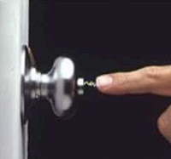
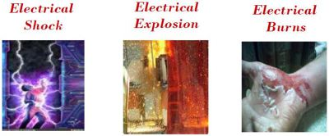

Slide 77
Electricity travels in closed circuits, and its normal route is through a conductor. Shock occurs when the body becomes a part of the electric circuit. Electric shock can cause direct injuries such as electrical burns, arc burns, and thermal contact burns. It can also cause injuries of an indirect or secondary nature from involuntary muscle contractions from the electric shock. These injuries can include bruises, bone fractures, and even death resulting from collisions or falls. Death may also occur from damage to internal organs and cardiac arrest. Electrical shock generally occurs from contact in one of three ways:
• Both wires of the electric circuit
• One wire of the energized circuit and the ground
• A metallic part that has become energized by being in contact with an energized wire, and another part or ground.

Slide 78
The severity of the shock received when a person becomes a part of an electric circuit is affected by three primary factors:
• The amount of current flowing through the body (measured in amperes).
• The path of the current through the body.
• The length of time the body is in the circuit
Other factors that may affect the severity of shock are the frequency of the current, the phase of the heart cycle when shock occurs, and the general health of the person prior to shock.

Slide 79
Common Laboratory Electrical Hazards and Preventative Steps
Laboratories are unique environments with many potential electrical hazards. Fortunately, simple precautions can be taken to reduce the risk:
New equipment may have different hazards than those you are familiar with. Before operating new equipment read and follow all equipment operating instructions for proper use.
Access panels and covers may shield high voltages.
Do not take apart laboratory instruments or attempt electrical repairs unless you are a qualified technician assigned to perform electrical work by your supervisor.
Fixed wiring may only be repaired or modified by Facilities personnel or an approved outside repair service vendor
Wet hands, salt solutions, and some anti-static devices may enhance electrical contact with the body.

Slide 80
Wet hands, salt solutions, and some anti-static devices may enhance electrical contact with the body. Use extra caution and ground fault circuit interrupter (GFCI) devices when these conditions exist.
Remove rings, watches and other jewelry, which may become part of an electrical circuit when working around electricity.
The accidental or unexpected starting of electrical equipment can cause severe injury or death. Common laboratory equipment that may automatically start includes:
Vacuum Pumps (may start from remote pressure transducer or instrument controller).
Air compressors (may start on demand from pressure set point)
Auto samplers (may move under computer or instrument control)
Ovens (thermostat controlled)
Cryostats (thermostat controlled)
Chillers (thermostat controlled)
Air Conditioners (thermostat controlled)

Slide 81
Lasers (many have a safety delay in producing a beam, or warm up time for tubes or cavities)
Sump or feed pumps (actuated by fluid level) Employees must follow the DRI Energy Control (lock-out/tagout) Program.
Unplugging something does not necessarily make it safe. Capacitors may store a lethal charge and battery circuits, such as those found in Uninterruptible Power Supplies, also remain live. Be extra cautious with these types of devices and apply the applicable energy controls techniques to mitigate the hazard.
Instruments in breadboard (developmental) form must be energized only under the direct supervision of the technician, and not left unattended while live unless protective measures are taken to exclude accidental contact with any exposed hazards.
Finished devices fabricated for experimental purposes must be sufficiently enclosed to preclude contact with any exposed hazards and be properly grounded.
Improper use of extension cords is harzadous.

Slide 82
If you need additional power supply, the best solution is to have additional outlets installed by Facilities.
Do not use extension cords or power strips ("power taps") as a substitute for permanent wiring. Never daisy chain extension cords or power strips to get power where it is needed.
Corrosives found in the laboratory environment may deteriorate wiring or insulation. Common causes of cracked insulation are the mineral acids and bases, ozone, heat, and ultraviolet light. Inspect all electrical and extension cords for wear and tear. Pay particular attention near the plug and where the cord connects to the piece of equipment. If you discover a frayed electrical cord or corroded contacts, lock the equipment out and make arrangements for repair before reuse.
Many electrical devices are also potential ignition sources. Never store flammable liquids such as solvents or fuels near electrical equipment, even temporarily.
Avoid cluttered work areas and benches because they invite accidents and injuries. Good housekeeping and a well-planned layout of temporary wiring will reduce the dangers of fire, shock, and tripping hazards. Electrical equipment must not be installed near eye wash/safety shower stations.

Slide 83
3. Safe Use of Electrophoresis Equipment
Electrophoresis units present several possible hazards including electrical, chemical, and radiological hazards. All of these hazards need to be addressed before using the units. EH&S has prepared these guidelines to assist researchers in safely operating electrophoresis units.
• Proper Equipment Set-Up
Place electrophoresis units and their power supplies so that the on/off switch is easy to reach and the power-indicator lights are easily seen.
Locate the equipment where it will not be easy to knock or trip over. Because electrophoresis work involves handling conductive liquids around electricity, power supplies should be protected by Ground Fault Circuit Interrupters (GFCIs).
GFCIs act as very sensitive circuit breakers and, in the event of a short circuit, will stop the power before it can hurt a person. You can identify GFCIs by their "test" and "reset" buttons.

Slide 84
• Addressing Electrical Hazards
Electrophoresis units use very high voltage (up to 2000 volts) and potentially hazardous current (80 milliamps or more). This high power output has the potential to cause a fatal electrical shock if not properly handled.
Routinely inspect electrophoresis units and their power supplies to ensure they are working properly. Power supplies should be inspected to ensure that all switches and lights are in proper working condition, that power cords and leads are undamaged and properly insulated, and that "Danger-High Voltage" warning signs are in place on the power supply and buffer tanks. Inspect the buffer tanks for cracks or leaks, exposed connectors, or missing covers. If your units have such hazards, replace them or perform necessary retrofitting before use.

Slide 85
• Training and Work Procedures
Principal Investigators are responsible for providing instruction on the safe use of electrophoresis units to those in the laboratory who work with them. The instruction should cover the operating procedures written by the manufacturer or laboratory, as well as the associated hazards, the correct personal protective equipment, and applicable emergency procedures. As with all safety training, this instruction should be documented. Employees must wear all appropriate personal protective equipment when working with electrophoresis units, including lab coats, gloves, and protection.
Do not leave electrophoresis units unattended for long periods of time since unauthorized persons may accidentally come in contact with the unit, or the buffer tank liquid may evaporate, resulting in a risk of fire.
Laboratories that perform electrophoresis work during off hours should consider using a "buddy system" to ensure that emergency services can be notified if someone is injured or exposed. It is also recommended that laboratory personnel be trained in CPR and First Aid.(Classes are periodically scheduled at DRI or can be taken at various locations in the community.

Slide 86
CONCLUSION
Hazards are quite dangerous to workers in both the laboratory, industries and companies. But due to certain guidelines,steps,rules and bodies governing the protection of the lives and individuals, the risk of danger and accidents has been reduced.
There are better improvements in technological equipment thus, resulting to advancements in research and experimental analysis.
REFERENCES
www.google.com
www.Wikipedia.com
www.laboratoryequipments.com

